Slide 1

16-BIT COMPUTER
PROF.DR : Mohamed El-Habrouk

Slide 2
TEAM MEMBERS
AHMED MOHAMED 51
IBRAHIM MOHAMED 12
MOHANED HASSAN 371
ZIAD ALI SHABANA 153
KEROLLOS EMAD 250
DINA HASSAN 117
OMAR MOHAMED 224
OMAR G.ABO SHABANA 213
MOUSTAFA AL DEGHEDY 357
MAHMOUD YOUSRY 336

Slide 3
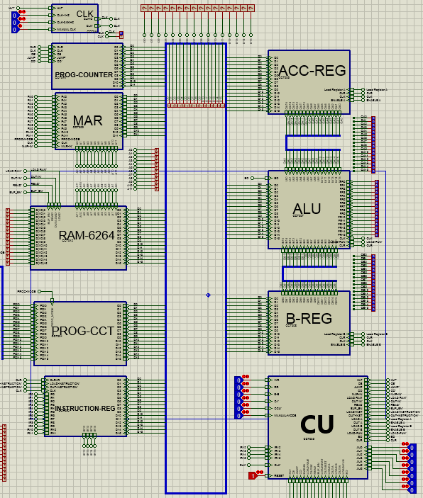
PROCESSOR OVERVIEW
MAIN PARTS:
CLOCK
PROGRAM COUNTER
MEMORY ADDRESS REGISTER
RAM
PROGRAMMING CIRCUIT
INSTRUCTION REGISTER
ACCUMLATOR REGISTER
ALU
B-REGISTER
CONTROL UNITE

Slide 4
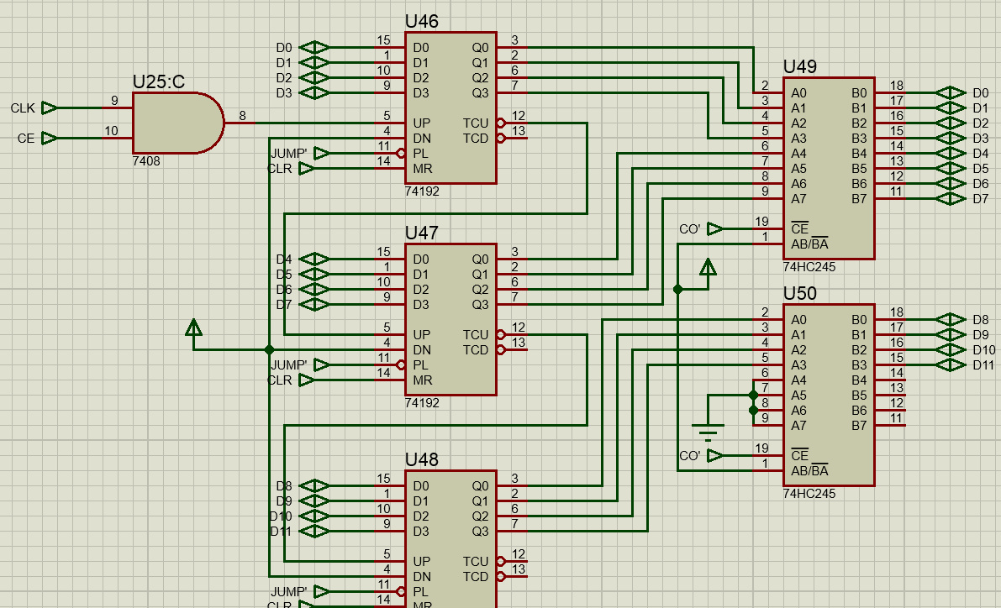
PROGRAM COUNTER
COMPONENTS :
Binary Counter : 74192
Tri-state Buffer : 74254

Slide 5
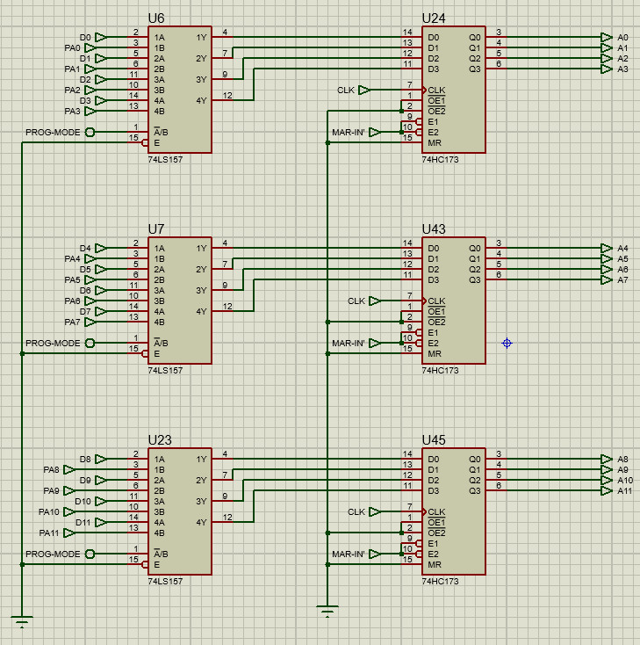
MEMORY ADDRESS REGISTER
COMPONENTS:
Multiplexer : 74157
4-BIT Register : 74173

Slide 6
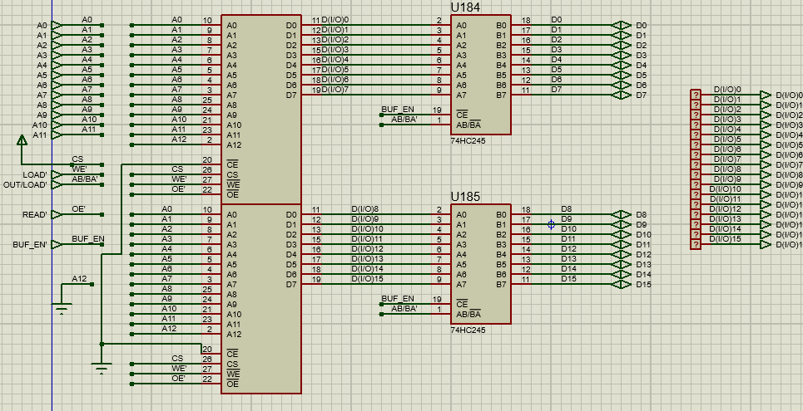
RAM
COMPONENTS:
8K – RAM : 6264
TRI-State buffer :74245

Slide 7
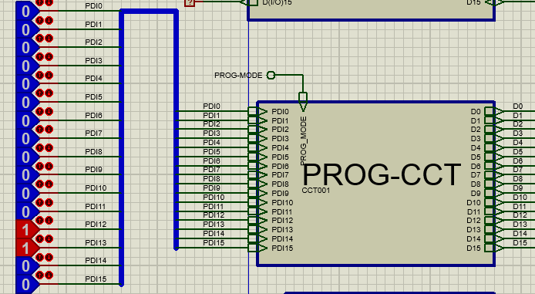
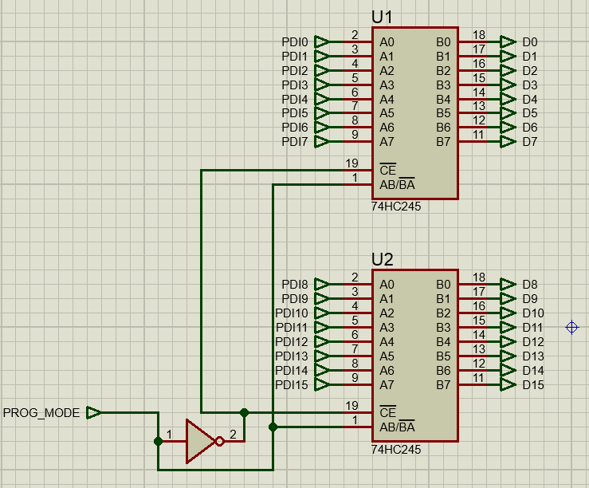
PROGRAMING CIRCUIT
TRI-STATE BUFFER : 74245
FOR PROGRAM THE RAM

Slide 8
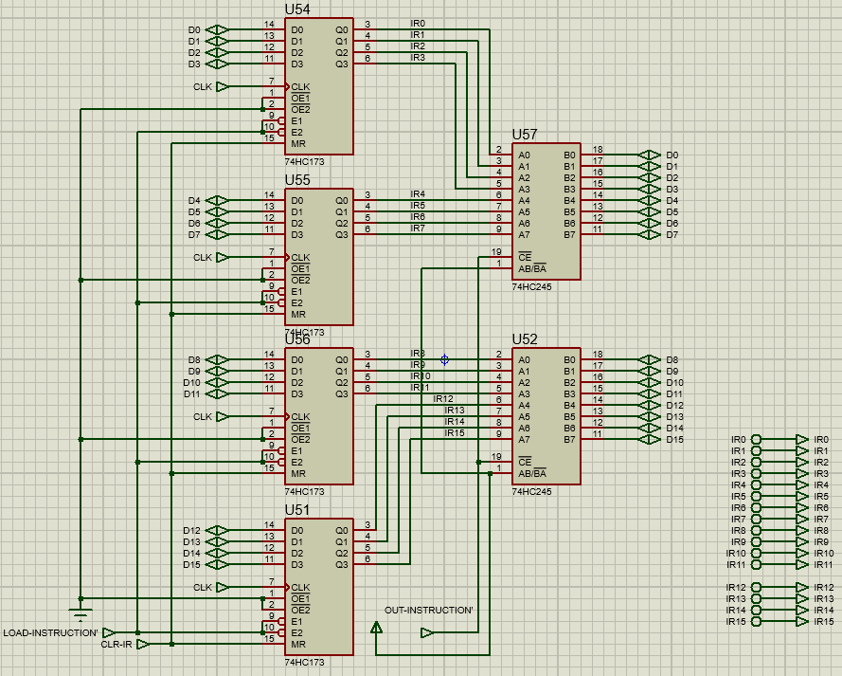
INSTRUCTION REGISTER
COMPONENTS:
REGISTER :74173
TRI-STATE BUFFER :74245

Slide 9
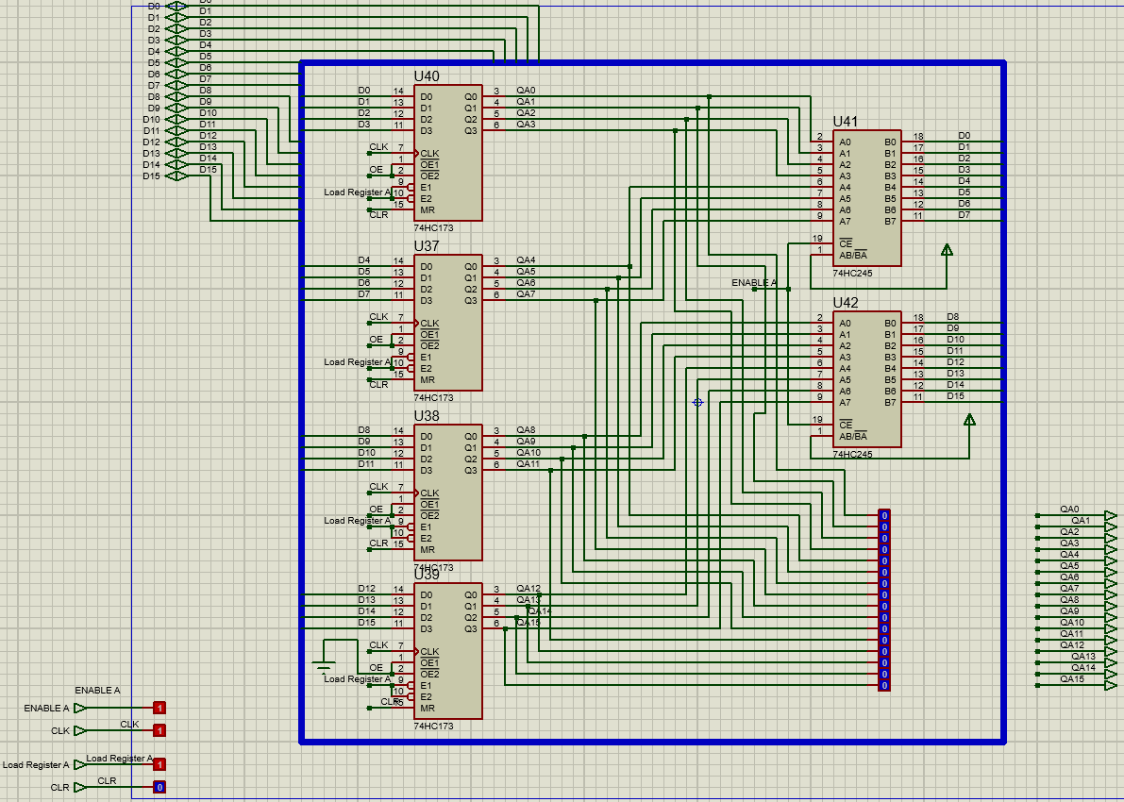
ACCUMLATOR REGISTER
COMPONENTS:
REGISTER :74173
TRI-STATE BUFFER :74245

Slide 10
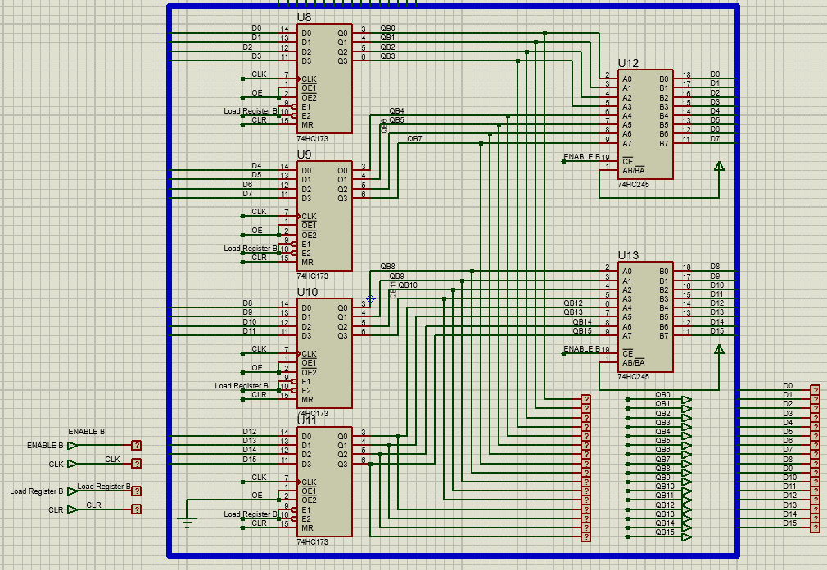
B-REGISTER
COMPONENTS:
REGISTER :74173
TRI-STATE BUFFER :74245

Slide 11
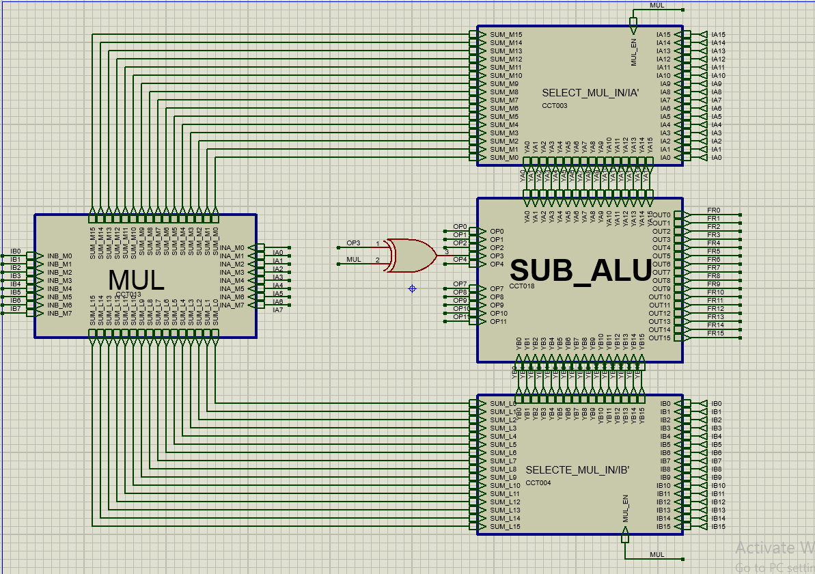
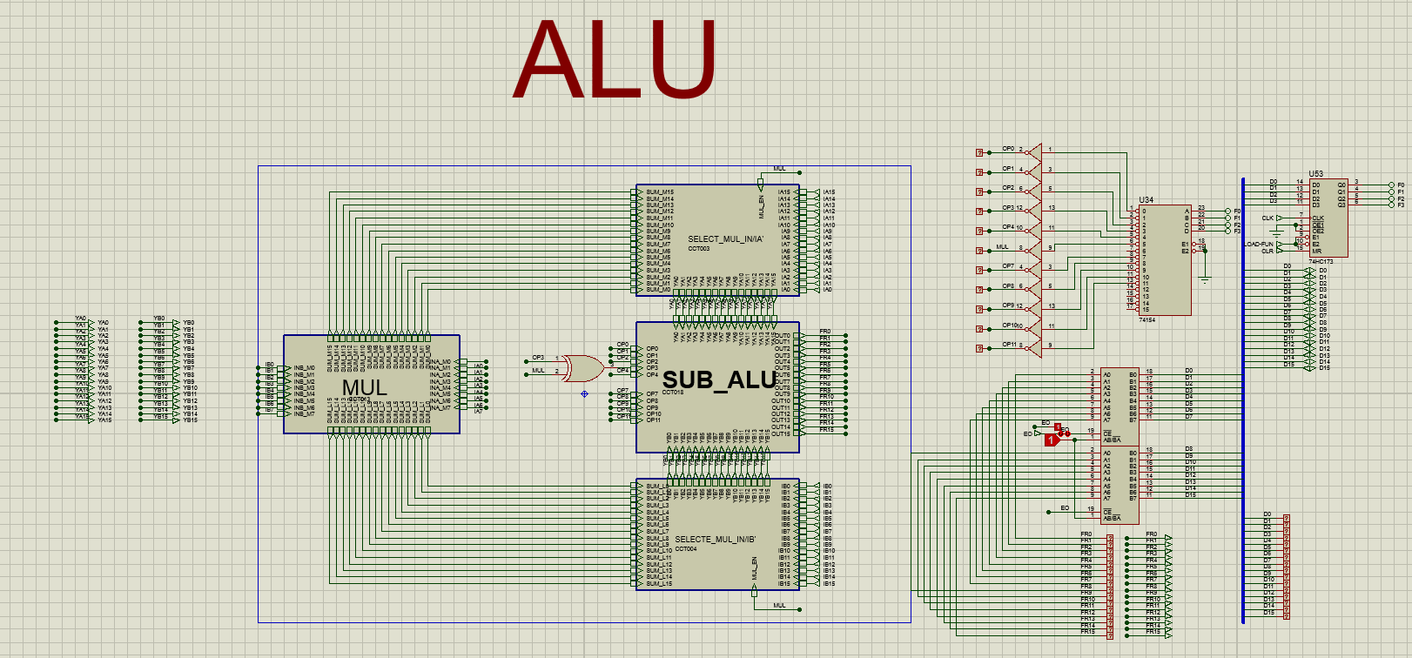
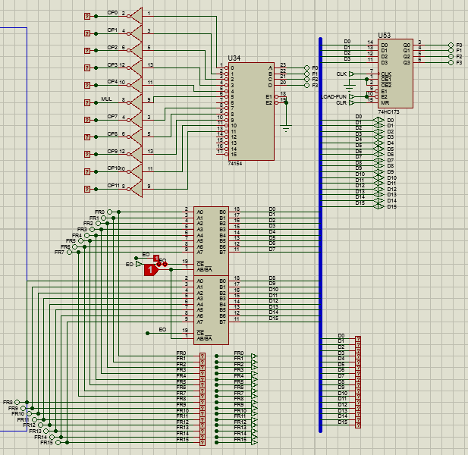
ALU

Slide 12
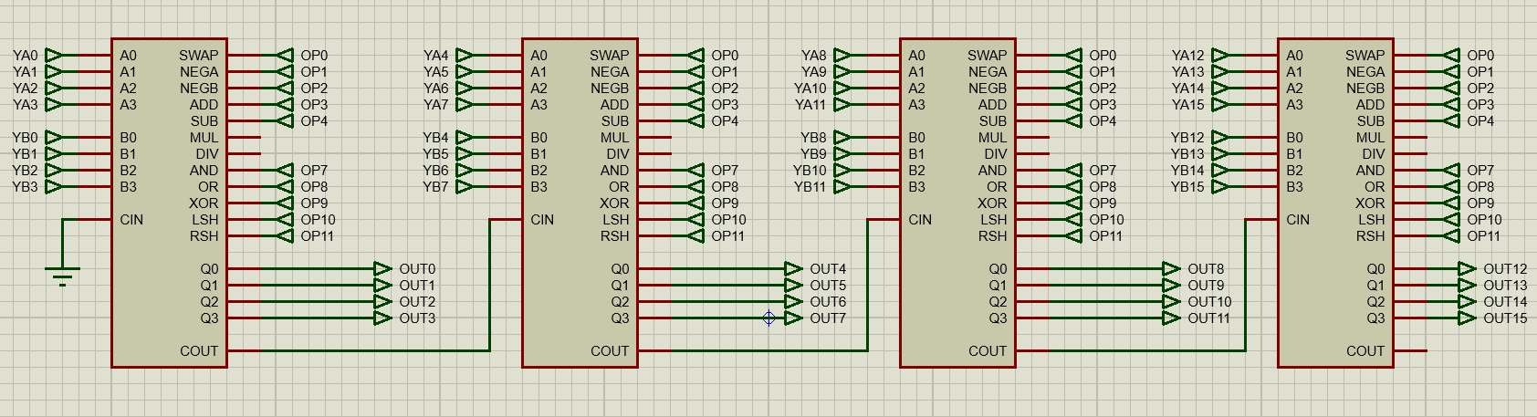
ALU

Slide 13
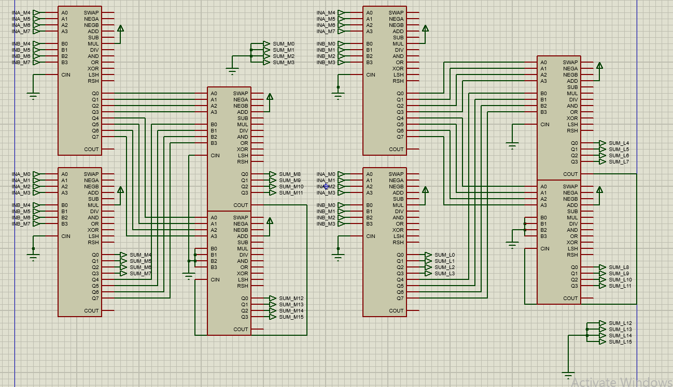
ALU

Slide 14
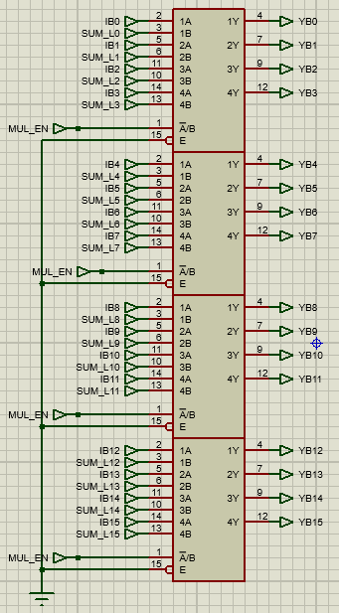
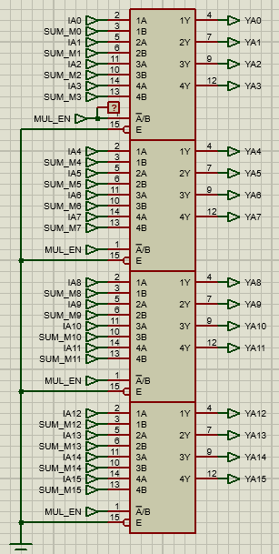
ALU

Slide 15
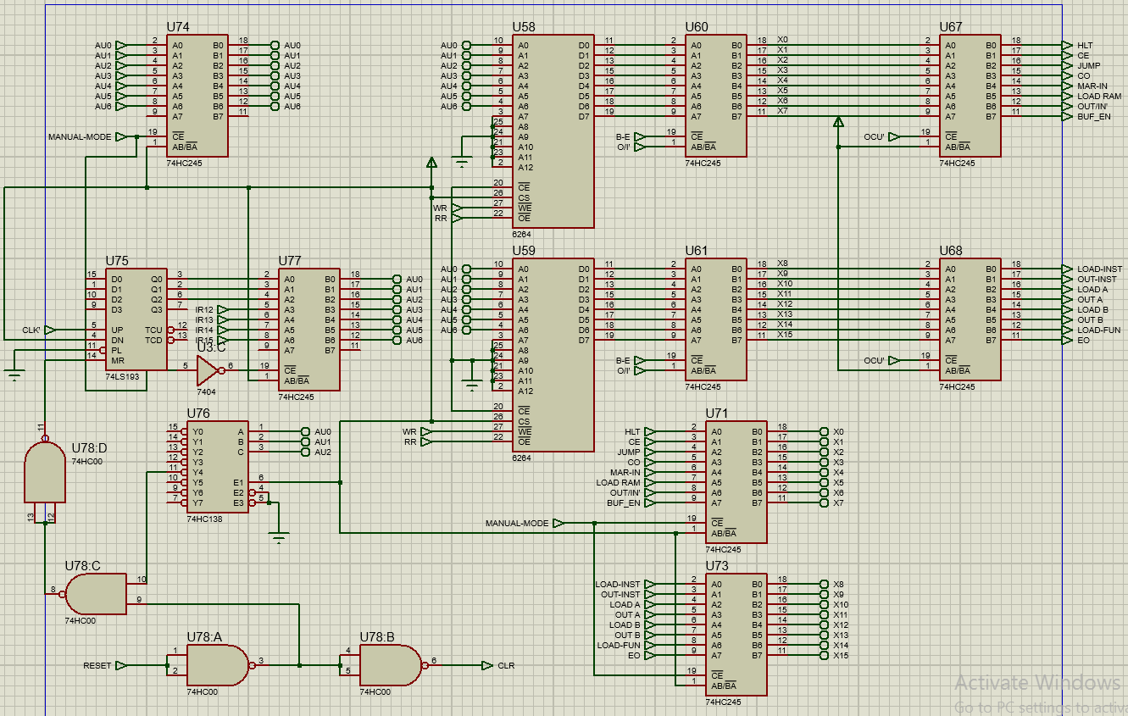
CU

